Slide 1

ETHICS IN ENGINEERING

Slide 2
Content
Scope of Engineering ethics
Accepting & Sharing Responsibilities
Responsible Professional & Ethical Corporations
Resolving Ethical Dilemmas
Case study

Slide 3
SCOPE OF ENGINEERING ETHICS

Slide 4
Content
Why Engineering
Ethics
Difference between Morals & Ethics

Slide 5

Why you selected Engineering as your career option?
What is engineering?

Slide 6
Difference between Morals & Ethics
Morals:
The word “Morality” originates from the Latin word “mos” meaning “custom”. Morals are the principles or habits with respect to right or wrong of one’s own conduct. They are not imposed by anyone. Morals are what you think is good and bad personally.

Slide 7
Ethics
The term is derived from the Greek word ethos which can mean custom, habit, character or disposition.
Ethics are the principles accepted by the society, which also equate to the moral standards of human beings.

Slide 8
What is the need of Ethics in Engineering?
“An engineer with ethics can help the society in a better way.”

Slide 9
Why we need to study Engineering ethics?
To understand governing standards, what is acceptable behavior in the practice of engineering…

Slide 10
Scope of Engineering Ethics
Ethical Standards in Engineering are Influenced by the factors mentioned in the next diagram.
  Engineering as social experiment
  Ethics and excellence
  Personal Commitment and Meaning
  Promoting responsible conduct and preventing wrong doing
  Ethical dilemmas
  Micro and Macro Issues

Slide 11
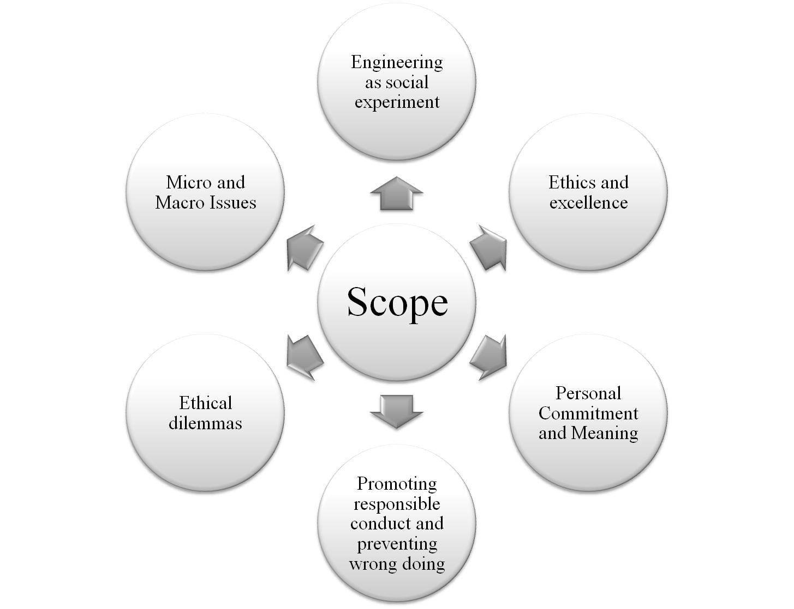

Slide 12
THANK YOU

